Slide 1
Summer Mentorship Program IITK-2022
Group Members:
Subhadeep Das(leader)
Srijani Adhikary
Sahil Mallick

Slide 2
Credit Default Prediction

Slide 3
Objective: To predict whether a customer will default in future

Slide 4
Data Description
train_data
Information of the customers for a 13 months window ( March, 2017 to March,2018 ).
Observations: 5531451
train_labels
‘target’ for each customer ID which takes the value 1 if the customer defaults and takes the value 0 otherwise.
Observations: 458913
test_data
Information of 924621 customers for 18 months window ( April, 2018 to October, 2019)
Observations: 11363762
There are 190 variables in total out of which 11 variables are categorical.
Features fall into the following general categories: Delinquency, Spend, Payment, Balance and Risk.

Slide 5
Feature Engineering And Feature Selection :
Divided the train data into six different segments : numerical features of Delinquency, Spend, Payment, Balance and Risk variables and all categorical variables.
After bringing the data at customer_ID level by aggregation, catboost, random forest and decision tree classifier are fitted in each segment to get the feature importance.
By Weight Of Evidence method Information Value is obtained for each feature.
Using Recursive Feature Elimination technique we ranked the features.
Comparing all the 5 methods 50 raw variables are selected from all the segments combined.

Slide 6
2nd Stage Feature Selection :
Created the some aggregated features along with new features like mean of last 3 values, flag variables based on mean+3*std etc. on 50 raw variables.
We end up with 398 derived features in total.
Top 37 features which contributed to 90 percent of the total importance are selected using CatBoost Classifier.

Slide 7
Model Fitting :
On comparison of different models using pycaret library catboost, lightgbm and xgboost came out to be the top 3 models with highest AUC’s.
We fitted these 3 models on ‘train_data’ and scored it on ‘test_data’. On submission we got the scores 0.127, 0.3 and 0.54 respectively.

Slide 8
Trying For Improvement :
To check the importance of the features segment wise, catboost classifier is fitted to each segment.
We got the following scores :
Delinquency | 0.539
Spend | 0.442
Payment | 0.434
Balance | 0.509
Risk | 0.443

Slide 9
Delinquency variables came out to be the most important among all the segments.
1st stage feature selection process was repeated by taking all 87 delinquency variable and sample of raw variables from other segments. In total 112 raw features were selected.
In 2nd stage out of 810 derived feature 46 were chosen which contributed to 90 percent of the total importance by catboost classifier.
Catboost, lightgbm and xgboost came out to be the top 3 models and were fitted to our data.
The scores obtained were 0.547, 0.538 and 0.541.
We consider this catboost model as our final model.

Slide 10
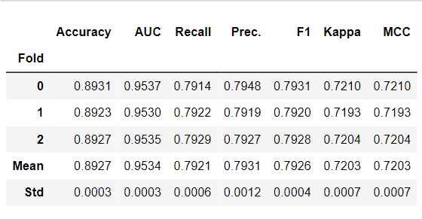
Performance measures for the final catboost model is shown below :

Slide 11
Thank You

